Slide 1
Drug information
Here is where your presentation begins
By: Dr. Riffat Ibrahim Riffat

Slide 2
What is randomization
Randomization is the process of assigning clinical trial participants to treatment groups.
Randomization gives each participant a known and equal chance of being assigned to any of the groups.
Successful randomization requires that group assignment cannot be predicated in advance.

Slide 3
Advantages of randomization
Elimination of selection Baias.
Allows for comparability between groups.
Balances arms with respect to prognostic values.

Slide 4
Disadvantages of randomization
Trials which test for efficacy may not be widely applicable.
Trials which test for effectiveness are larger and more expensive.
Results may not always mimic real life treatment situation (e.g. inclusion / exclusion criteria; highly controlled setting)

Slide 5
Methods of randomization
Simple method randomization.
Unequal allocation randomization.
Stratified randomization.
Blocked randomization.

Slide 6
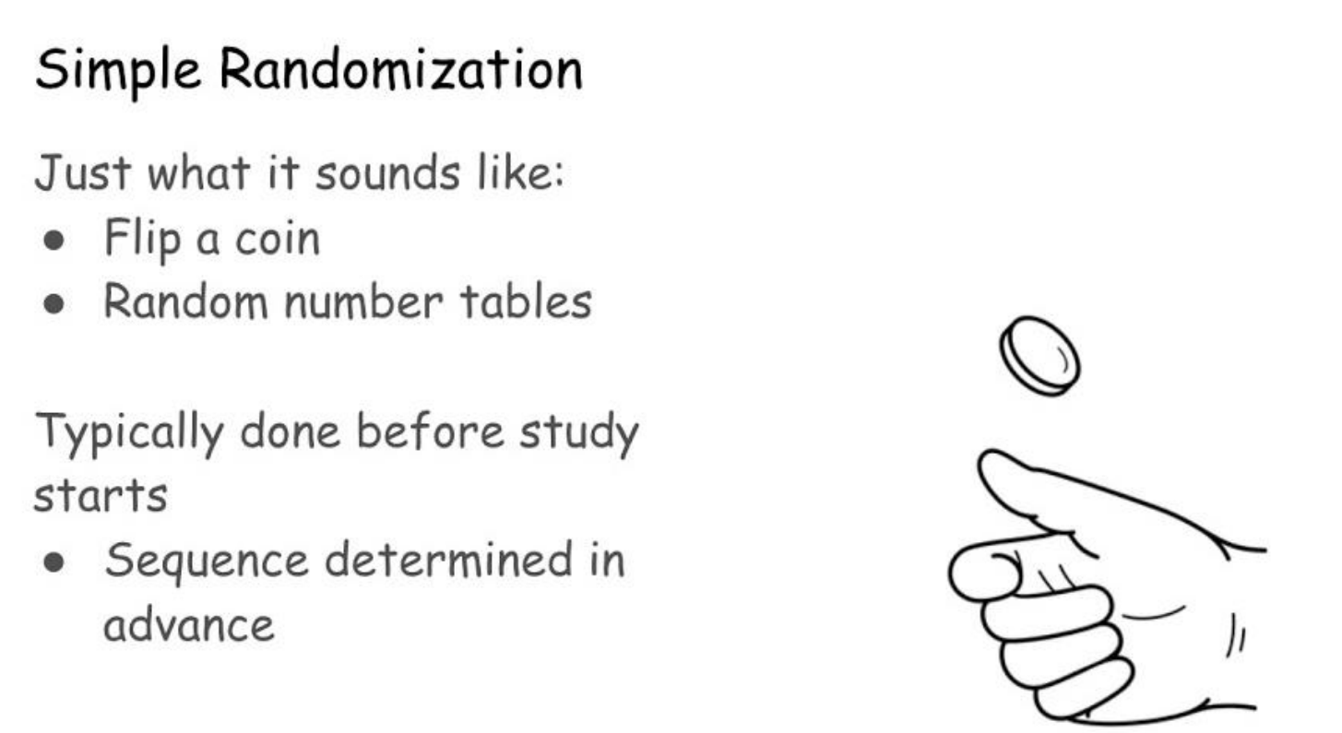

Slide 7
Unequal allocation randomization.
Unequal allocation randomization is a method used in clinical trials where participants are assigned to study groups (e.g., intervention and control groups) in proportions that deviate from the typical 1:1 ratio.
Instead, the allocation may follow a ratio such as 2:1, 3:1, or even more extreme ratios.
This approach can be strategically applied depending on the objectives of the trial.

Slide 8
Unequal allocation randomization.
When two or more treatments under evaluation have a cost difference:
  Substantial cost savings can be achieved by adopting an unequal randomization ratio such as 2:1, with only a modest loss in statistical power.
  Another scenario: When one arm saves lives, and the other (such as placebo/medical care only) does not.
  Generally, a randomization ratio of 3:1 will lose considerable statistical power.

Slide 9
Stratified Randomization
Stratified randomization is a method used in clinical trials to ensure that key prognostic factors (confounding variables) are balanced between treatment groups.
By dividing participants into strata based on these factors and then performing randomization within each stratum, researchers aim to improve the comparability of groups and reduce variability in outcome estimates.

Slide 10
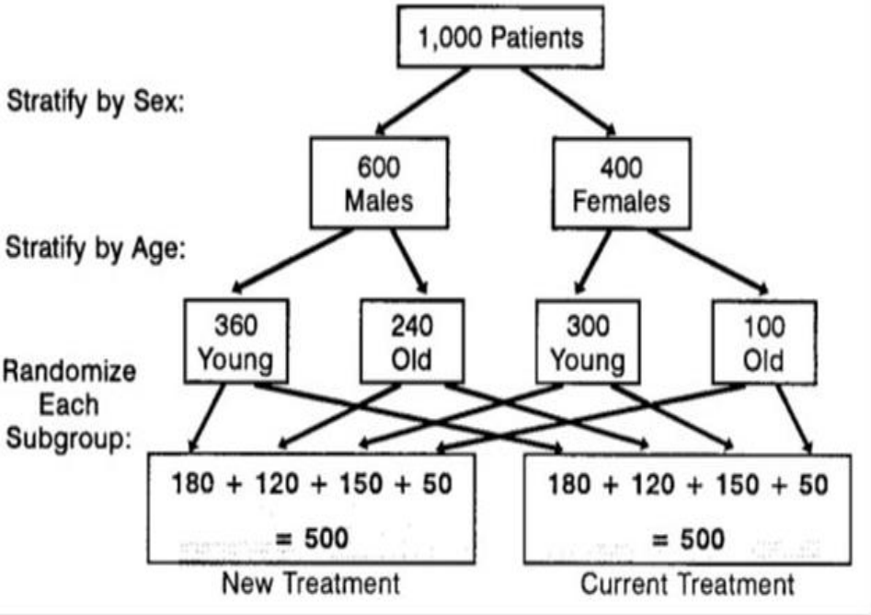

Slide 11
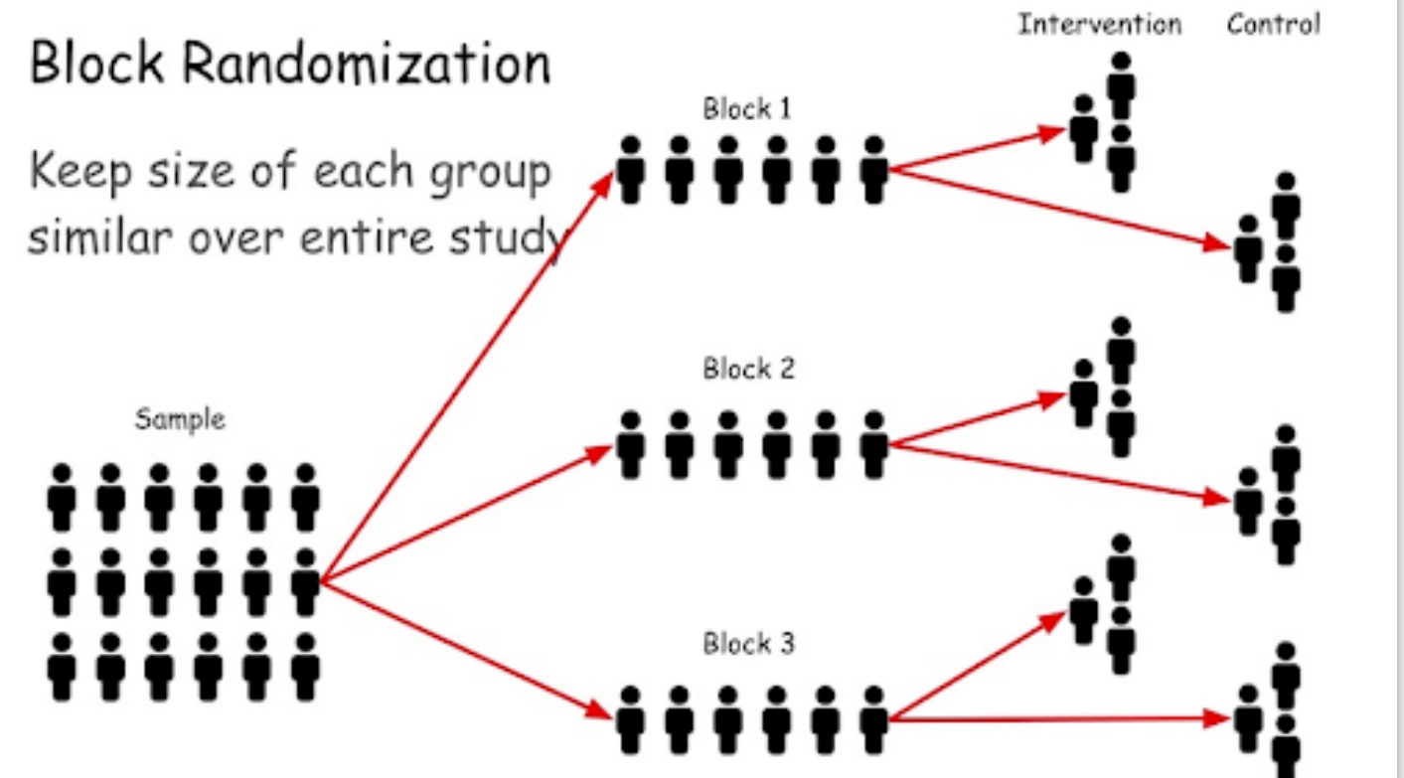

Slide 12
Blinding in Clinical Trials
Blinding keeps participants, clinical trial personnel (e.g., healthcare providers), or assessors (those collecting outcome data) unaware of an assigned intervention so that they are not influenced by that knowledge.
Blinding prevents bias at several stages of a trial, although its relevance varies according to circumstance.

Slide 13
